Slide 1



PRESENTATION
By Mohamed Emad

Slide 2

BACKGROUND
This project is taking about patients who have some diagnosis to check their health care
01

Slide 3
PROJECT GOALS
Making easy and readable analysis to do better service for those patients
02

Slide 4
PROBLEMS
1 - data was not clean and having nulls which was not sorted like null it was sorted like N/A
2- Transform data to dimensions and fact
After applying changes I found dates is recorded like numbers so I applied some changes in python code to change data type
04

Slide 5


TOOLS
1- KAGGLE ⟶ Extracting my data
2- Draw Io ⟶ Drawing my schema
3- Snowflake ⟶ Uploading Data
4- Collab ⟶ Working with python
5- Power bi ⟶ Making visualization
05

Slide 6
STEPS
1- Extracting data from kaggle
2- Uploading it SNOW FLAKE SCHEMA
3- Making a connection between snow flake and collab
4- Writing python code in notebook to clean data and make facts and dimensions
5- Using Snowflake sheets to write constraints
6- Using power bi to make insights
07

Slide 7
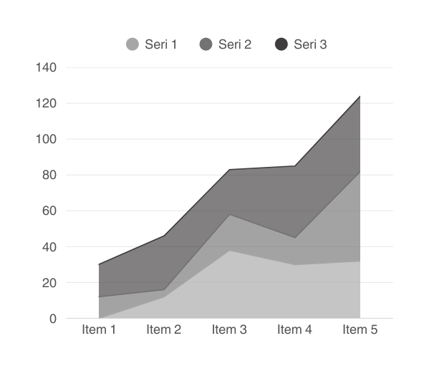
ANALYSIS
Using power bi to make the correct and readable insights to make it easy for assistant to check their priority
06

Slide 8
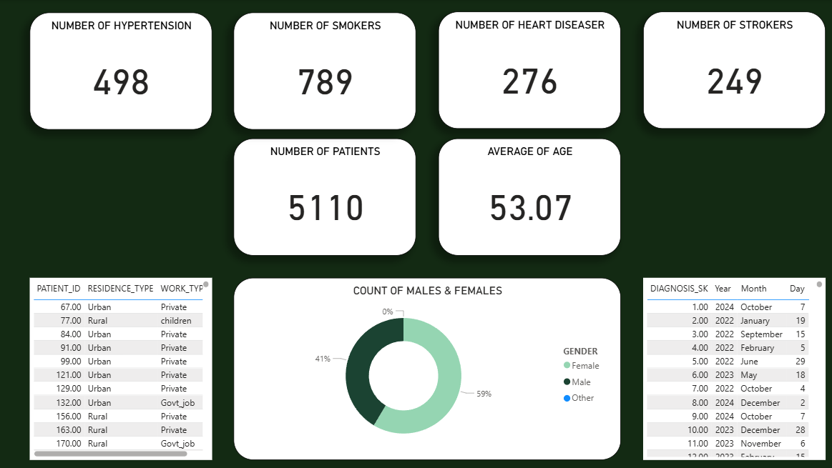
RESULT
08

Slide 9
CONCLUSION
Data ware house is here to help us to analyze data which is called place designed for analyzing structured data with a lot of tools and you can choose the one you will be comfort with so you can make good and right insights to help the business
09

Slide 10
THANK YOU
10

